Slide 1
Optimizing supply chain efficiency through predictive analytics: a data-driven approach
Cai Fuyuan
MCS231005
25/07/2024

Slide 2
Chapter 1 : Introduction
Chapter 2: Literature Review
Chapter 3: Methodology
Chapter 4: EDA/Initial Results
Chapter 5: Discussion and Future Work

Slide 3

Chapter 1 : Introduction
What is Supply Chain?
is a complex logistics system that consists of facilities that convert raw materials into finished products and distribute them to end consumers or end customers. Meanwhile, supply chain management deals with the flow of goods within the supply chain in the most efficient manner.
A diagram of a supply chain. The black arrow represents the flow of materials and information, and the gray arrow represents the flow of information and backhauls. The elements are (a) the initial supplier (vendor or plant), (b) a supplier, (c) a manufacturer (production), (d) a customer, and (e) the final customer.

Slide 4
Chapter 1 : Introduction
In the contemporary business environment of rapid technological advances and highly competitive markets, the efficiency of the actual supply chain operations has become one of the key influencing factors in determining the success or failure of business organizations, which must optimize their supply chain operations to maintain their competitive advantage. Traditional supply chain management approaches, which typically rely on reactive measures and historical data integration, often fail to address the complex and dynamic changes in modern supply chain systems. These traditional approaches struggle to provide the flexibility and foresight needed to navigate the volatile demands and unexpected disruptions of today's markets.

Slide 5
Chapter 1 : Introduction
Predictive analytics, an innovative approach that uses advanced algorithms and machine learning techniques to analyze historical data and predict future trends, offers a promising solution to these challenges. By anticipating future demand, identifying potential bottlenecks and optimizing resources across the supply chain, predictive analytics enables businesses to make proactive, data-driven decisions. This shift from reactive to proactive supply chain management not only improves operational efficiency, but also provides a significant competitive advantage.

Slide 6
Chapter 1 : Introduction
1.2 Background of Problem
The global supply chain landscape has changed significantly over the past few decades, driven by technological advances, globalization and changing consumer expectations, and the efficiency of supply chain operations is critical to the success of organizations. Despite these advances, many organizations still rely on traditional supply chain management practices, which are often reactive rather than proactive. Traditional supply chain management approaches are increasingly inadequate to meet the multifaceted challenges facing modern supply chains.

Slide 7
Chapter 1 : Introduction
1.3 Statement of Problem
(1) Increasing complexity: Modern supply chains are highly complex, involving numerous stakeholders, multiple segments, and a wide geographic range.
(2) Fluctuating demand: Market demand is becoming increasingly difficult to predict due to factors such as changing consumer preferences, economic fluctuations and seasonal changes.
(3) Inventory Challenges: Excessive inventory ties up capital and increases holding costs, while insufficient inventory leads to stock-outs and lost sales.
(4) Operational Inefficiency: Inefficient logistics and transport planning can lead to increased costs and longer delivery times.
(5) Supply chain disruptions: External disruptions, including natural disasters, geopolitical events and supplier issues, can seriously affect supply chain performance.
(6) Inadequate data utilization: Data silos, lack of integration and limited analytical capabilities hinder the potential to use data to gain predictive insights.

Slide 8
Chapter 1 : Introduction
1.4 Research Questions
(1) How can predictive analytics improve the accuracy of demand forecasting in supply chain management?
(2) How can predictive analytics be used to segment customers to improve supply chain efficiency and customer satisfaction?
(3) How does predictive analytics affect inventory optimization and cost reduction in supply chains?
(4) What are the key factors affecting the effectiveness of forecasting models in supply chain optimization?

Slide 9
Chapter 1 : Introduction
1.5 Objectives of the Research
The proposed project aims to achieve the following objectives:
(1) To conduct exploratory data analysis on a historical sales dataset to identify and visualize patterns, trends and correlations in the supply chain operations in this dataset.
(2) To perform predictive analyses of future sales from the historical data, using ARIMA and exponential smoothing models for time series analysis.
(3) To comprehensive evaluation of the developed predictive model using k-fold cross validation to assess the model performance.

Slide 10
Chapter 1 : Introduction
1.6 Scope of the Study
(1) Data collection and integration
Process: data cleansing, preprocessing, and integration using data warehousing and big data technologies to create unified datasets for analysis.
(2) Demand forecasting
Analyze historical sales data to identify trends and patterns.
(3) Supply Chain Stages
Inventory Optimization, Customer Insights, Logistics Optimization
(4) Model Evaluation and Validation
Apply cross-validation methods for the evaluation of generalization properties from predictive model.

Slide 11
Chapter 2 : Literature Review
This chapter examines recent research and developments in prognostic analytics for optimizing render concatenation efficiency. The search reviewed focuses on extremely so various aspects of furnish strand direction including exact forecasting inventory optimization customer insights and logistics. Key findings and methods in the literature ply a mean for savvy the potency and challenges of implementing prognostic analytics in render strand operations.
(1) Demand forecasting techniques
(2) Inventory Optimization
(3) Customer Insight
(4) Logistics Optimization
While the benefits of predictive analytics in supply chain management are clear, a number of challenges remain. Implementing predictive modelling requires significant data integration, computational resources and expertise. In addition, the dynamic nature of supply chains requires continuous model updates and real-time data processing. Future research should focus on integrating real-time data sources such as IoT devices and social media to improve the accuracy of predictions.

Slide 12
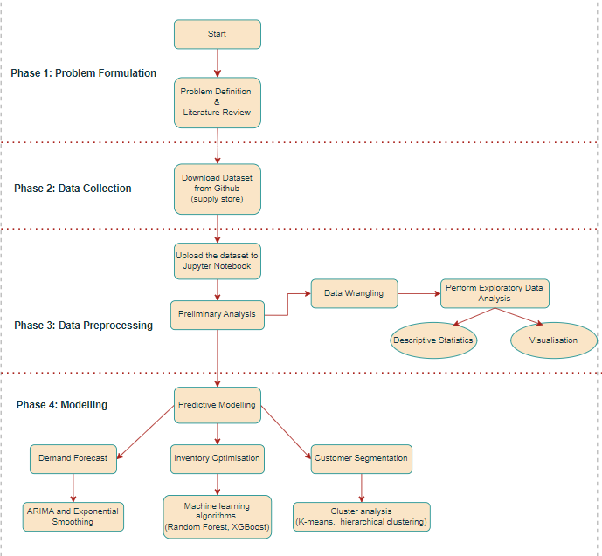
Chapter 3 : Methodology
3.1 Research design
This study uses a quantitative research design to analyze figures and data visualization to produce results to give recommendations. Quantitative methods are well suited to the application of this study as it involves analyzing large data sets to identify patterns, trends and relationships in supply chain operations. Specific methods include descriptive statistics, predictive modeling and machine learning techniques.

Slide 13
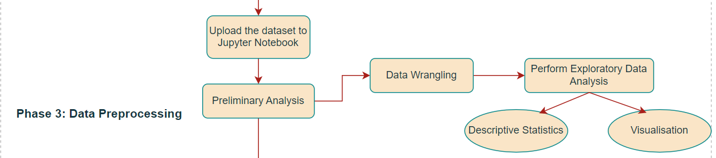
Chapter 3 : Methodology
3.2 Data collection and pre-processing
Data source: supply store dataset from Github
https://github.com/drshahizan/dataset/tree/main/mongodb/01-sales
Data cleaning: data was imported and cleaned to ensure accuracy and completeness, resolve missing values, inconsistencies, and outliers, standardize date formats and ensure consistency of categorical data, and create relevant variables for analysis.
Type of data | Volume | Velocity | Variety
Sales | More detail around the sale, including price, quantity, items sold, time of day, date, and customer data | From monthly and weekly to daily and hourly | Direct sales, sales of distributors, Internet sales, international sales, and competitor sales
Consumer | More detail regarding decision and purchasing behavior, including items browsed and bought, frequency, dollar value, and timing | From click through to card usage | Feature data for shopper satisfaction identification and preference level detection
Inventory | Perpetual inventory at more locations, at a more disaggregate level(style/color/size) | From monthly updates to hourly updates | Inventory in warehouses, stores, Internet stores, and a wide variety of vendors

Slide 14
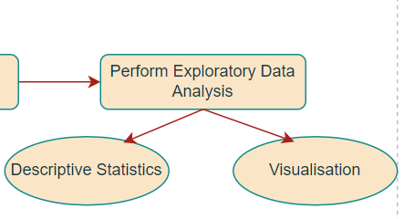
Chapter 3 : Methodology
3.3 Exploratory Data Analysis (EDA)
Descriptive statistics: use Python libraries such as Pandas and NumPy to calculate metrics such as mean, median, standard deviation, and distribution for key variables (e.g., sales, volume, customer satisfaction).
Visualization: Use histograms, bar charts, and box-and-line plots using Matplotlib and Seaborn to visualize other key metrics such as sales trends, seasonal patterns, product popularity, and customer demographics.
Correlation analysis: the Pearson correlation coefficient is used to identify relationships between variables such as sales volume, customer satisfaction and buying patterns to inform the predictive model.

Slide 15
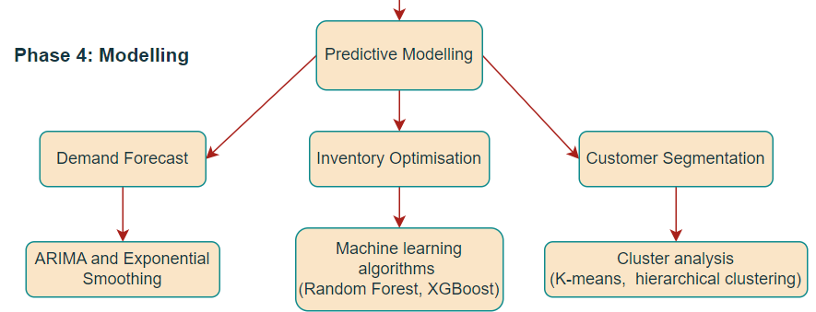
Chapter 3 : Methodology
3.4 Forecasting Modeling
Demand forecasting: time series analysis using SARIMA and exponential smoothing models to forecast future sales based on historical data. These analyses are performed using Python's tatsmodels library.
Inventory optimization: machine learning algorithms such as Random Forest and XGBoost are applied to recommend optimal inventory levels and reorder points. Scikit-learn and XGBoost libraries are used.
Customer Segmentation : Cluster analysis using K-means or hierarchical clustering to develop customer segmentation models by clustering customers based on purchase behavior and demographics. Scikit-learn library is used for clustering.

Slide 16
Chapter 3 : Methodology
3.5 Model evaluation and validation
Cross-validation: k-fold cross-validation is used to assess the model performance to ensure robustness and prevent overfitting.
Evaluation metrics: metrics such as Mean Absolute Error (MAE), Root Mean Square Error (RMSE) and Accuracy are used to evaluate model predictions. These are calculated using Python libraries such as Scikit-learn and Statsmodels.
3.6 Software and analytic frameworks
Python: the main programming language used for data analysis, containing libraries such as Pandas, NumPy, Matplotlib, Seaborn, Scikit-learn, Statsmodels and XGBoost.
Jupyter Notebooks: for interactive data analysis and visualization.
Power BI: for data visualization of analysis results.

Slide 17
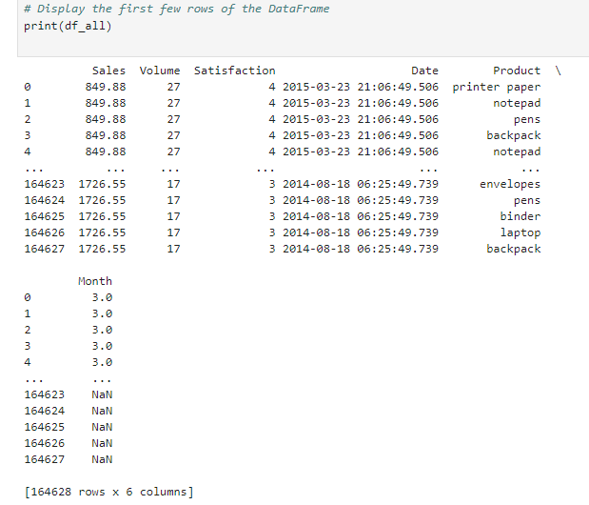
Chapter 4 : EDA/Initial Results
4.1 Descriptive statistics
By loading the dataset, it shows that the dataset has 6 columns and 164628 rows, and the data includes Sales, Volume, Satisfaction, Date, and Product, which belongs to a large database and is sufficient to support the data analysis in this paper.

Slide 18
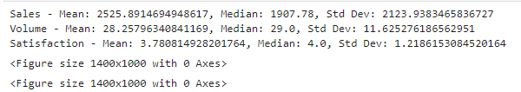
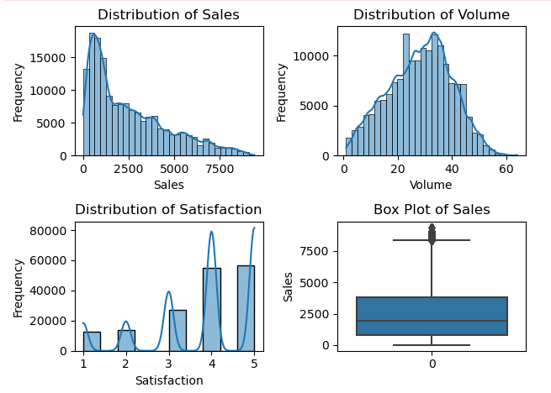
Chapter 4 : EDA/Initial Results
4.1 Descriptive statistics
After simple data processing, the mean, median, standard deviation, and distribution of some key variables (e.g., sales, volume, customer satisfaction) were first calculated. The run was very smooth, confirming that the dataset was of good quality.

Slide 19
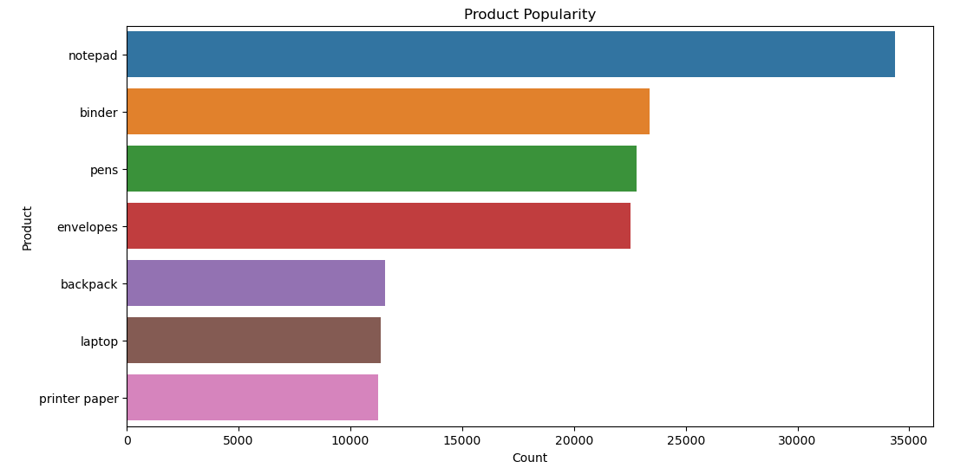
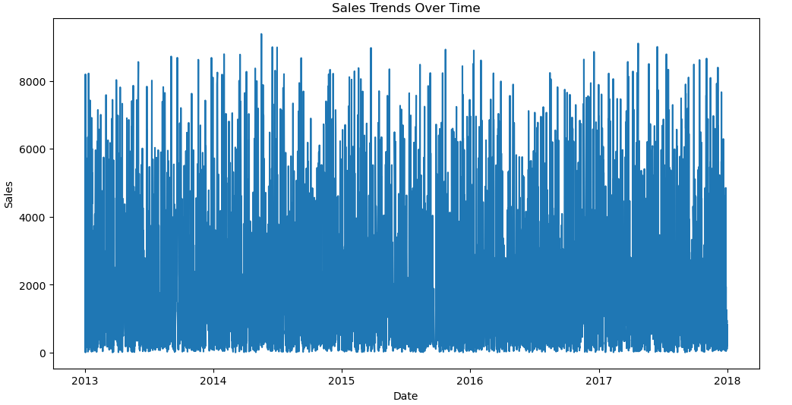
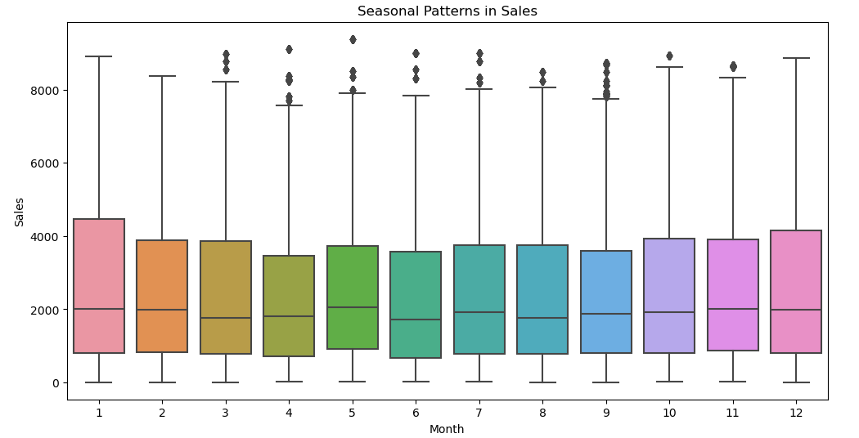
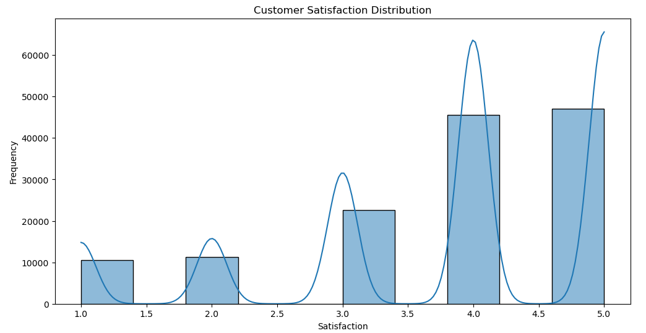
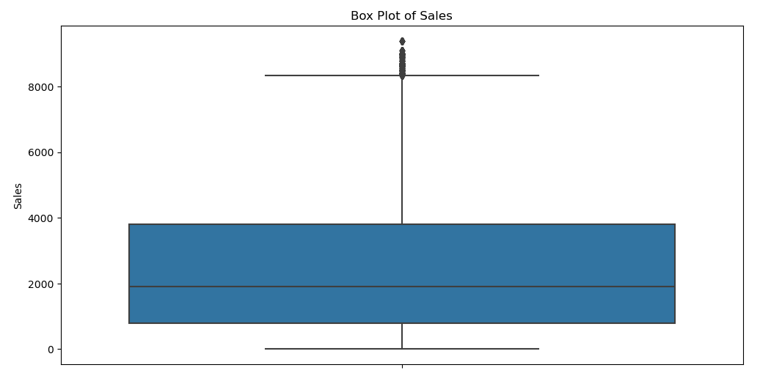
Chapter 4 : EDA/Initial Results
4.2 Visualization
Initial testing used histograms, bar charts, and box plots to visualize other key metrics such as sales trends, seasonal patterns, product popularity, and customer demographics.
This study entails depicting line graphs of sales over time, highlighting peak sales periods and seasonal trends i.e. sales trends. A bar chart showing the frequency of sales identifies the best selling products i.e. product popularity. Customer satisfaction can be seen by showing the distribution of satisfaction ratings for different store locations and purchasing methods in a box and line plot.

Slide 20
Chapter 5: Discussion and Future Work
Interpretation of the results of predictive analytics and assessment of their impact on supply chain efficiency. Recommendations for implementing data-driven strategies in inventory management, demand forecasting, and logistics. Recommendations for integrating real-time data sources (e.g., IoT, social media) to improve forecast accuracy. Explore advanced machine learning techniques (e.g., deep learning, reinforcement learning) for further optimization. Plans to continuously monitor and update forecasting models to adapt to changing market conditions.

Slide 21
Thank You

